Slide 1

Lohitha
Blood Cell Recognizer & Counter

Slide 2

Project Proposal
We talked about the following topics in the document
  Introduction
  Objective
  Functionality
  Technologies
  Extension
  Timeline

Slide 3
Requirements Gathering
Studying the existing system
  We met several MLTs in government hospitals
  Some of us had the chance to see the process in action
  We educated all the members about the existing process
We also got the users’ perspective
Requirements analysis and specification

Slide 4
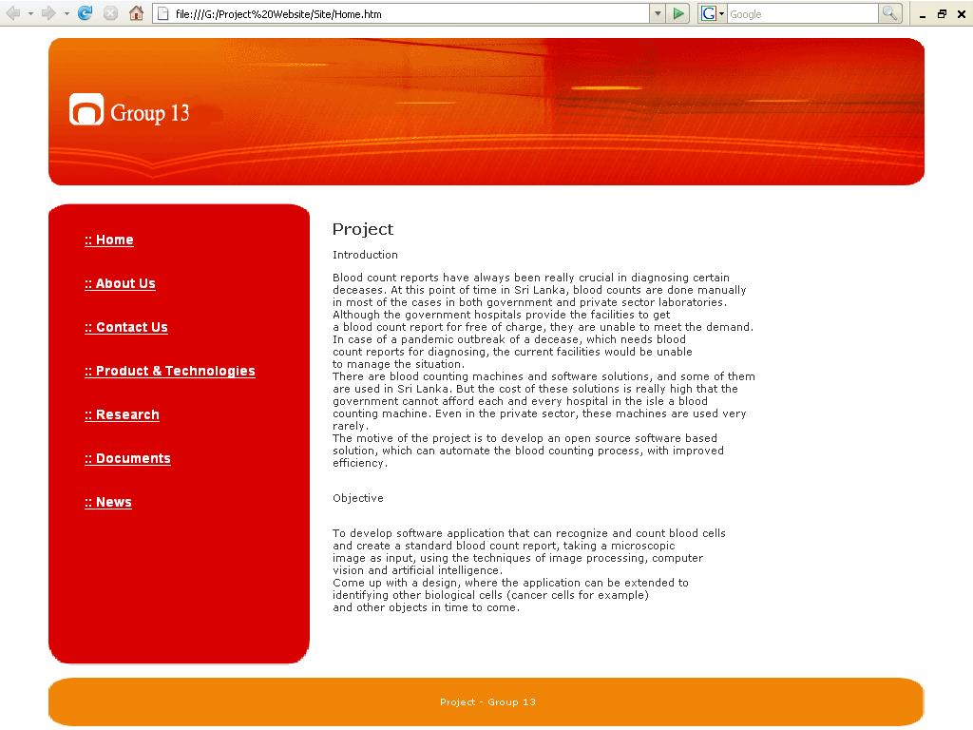
Website

Slide 5
Code Repository
Available at http://code.google.com/p/lohitha/
Open Source
GPL 2.0
Features
  Subversion code repository
  Issue Tracking
  Activity Modification

Slide 6
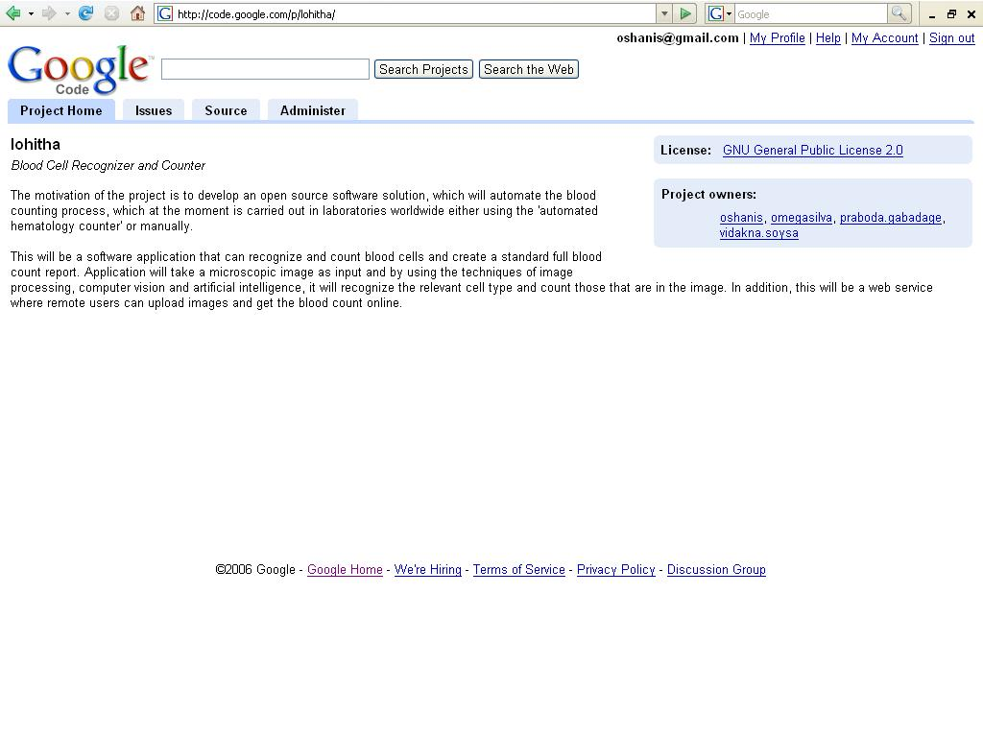

Slide 7
Wiki
Available at http://lohitha.wiki.com/
Meant to be used as an online knowledge base containing:
  Meeting Minutes
  Design Notes
  Resources gathered from the literature survey
  Coding Conventions

Slide 8
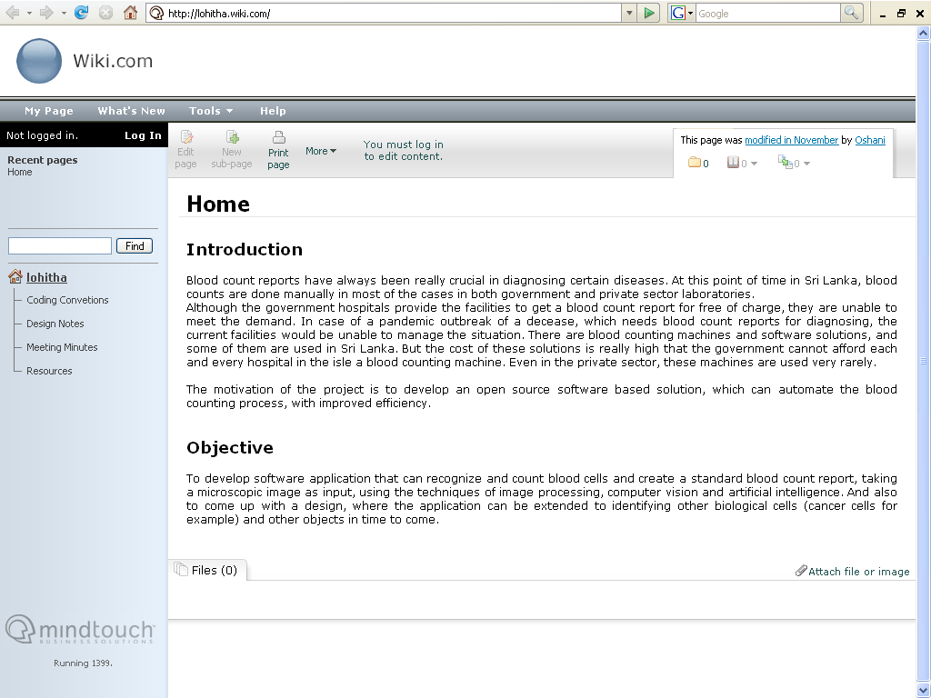

Slide 9
Literature Survey
On going…
We maintain a list of the resources we gather at our wiki knowledge base.

Slide 10
Prototype
Started developing using Matlab
Plan to finish Lohitha prototype version 1 by the end of next week

Slide 11
Thank You!

